Slide 1
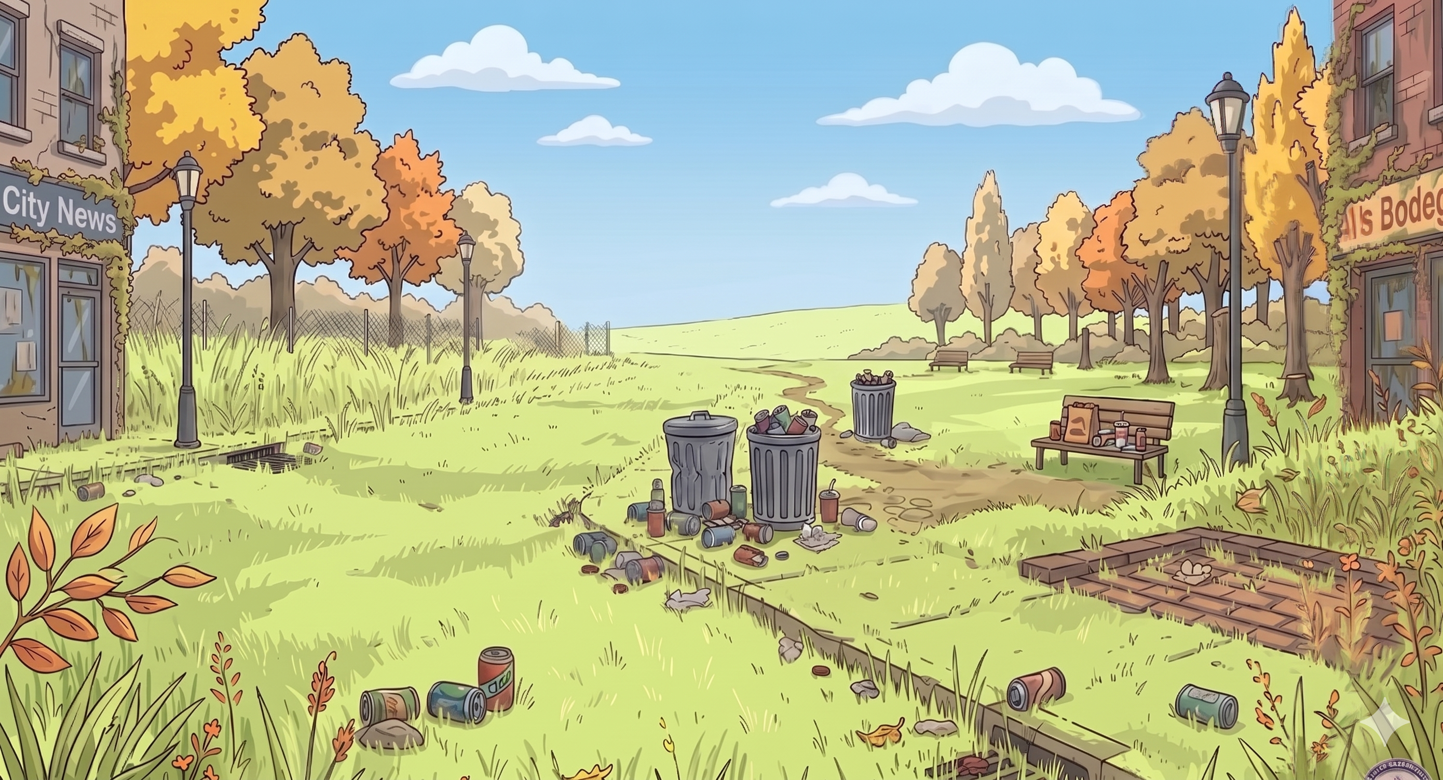
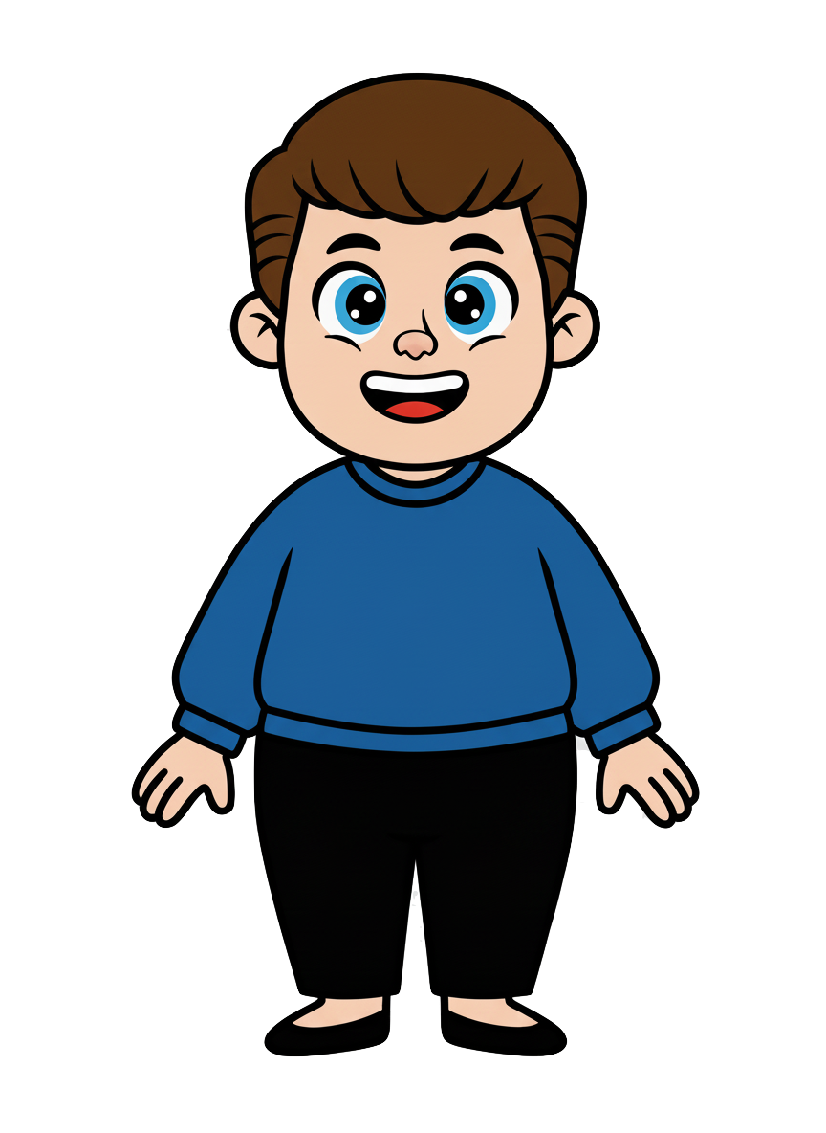
This is Kai

Slide 2
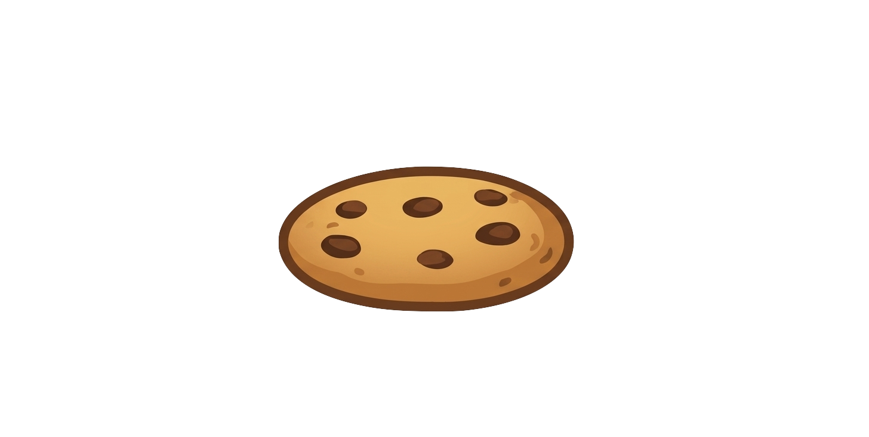
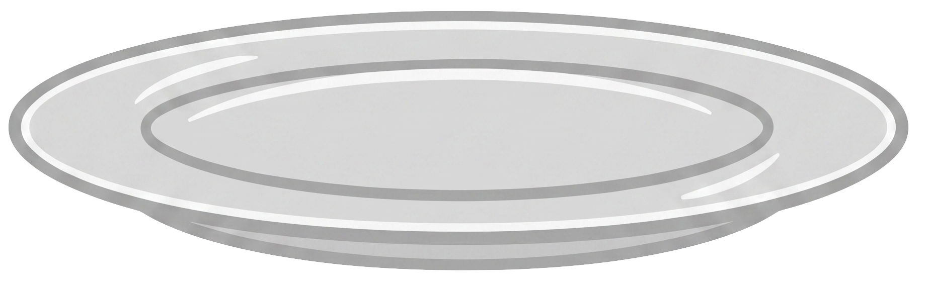
Kai has 7 cookies

Slide 3
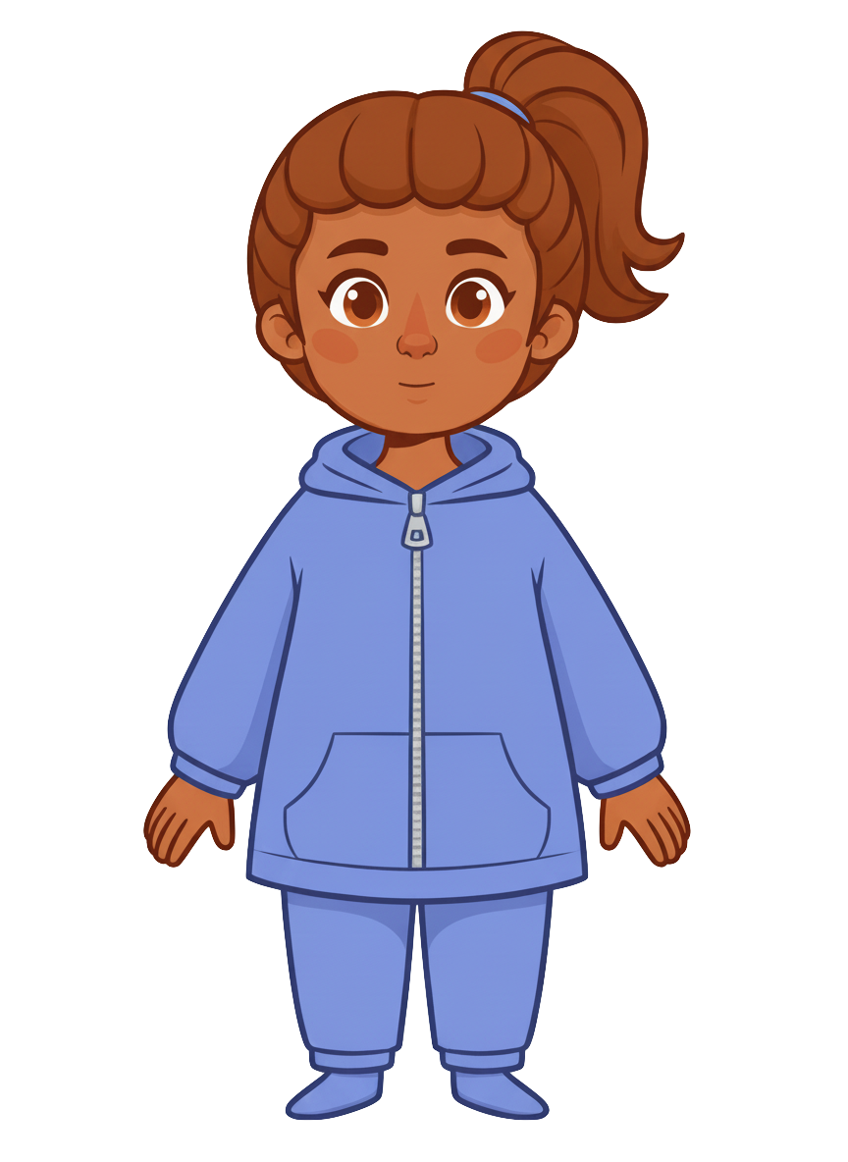
This is Ruby

Slide 4
Ruby has 7 cookies

Slide 5
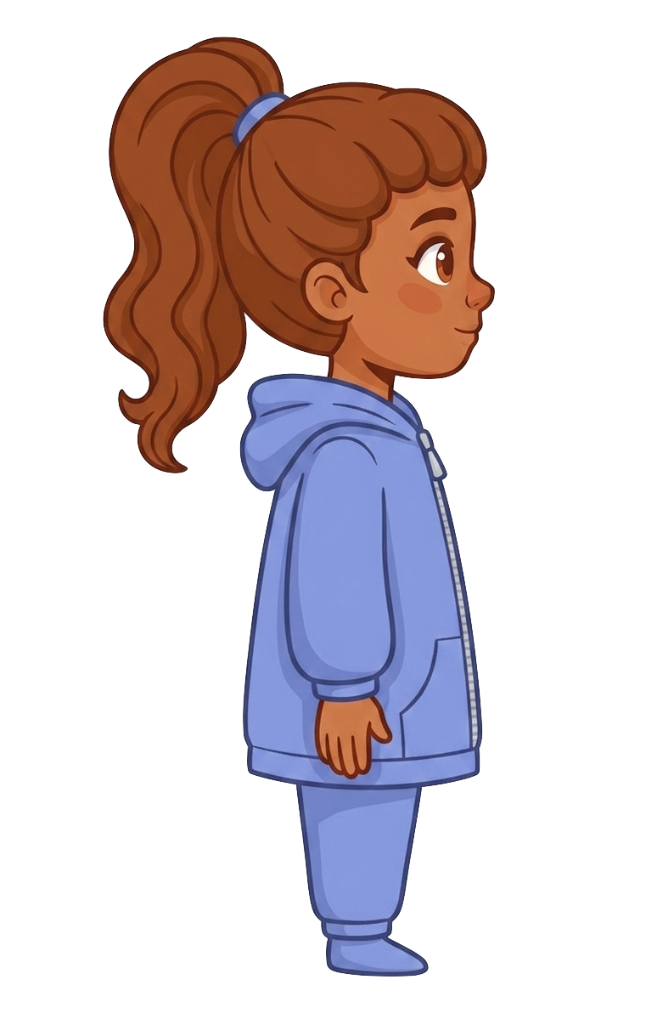
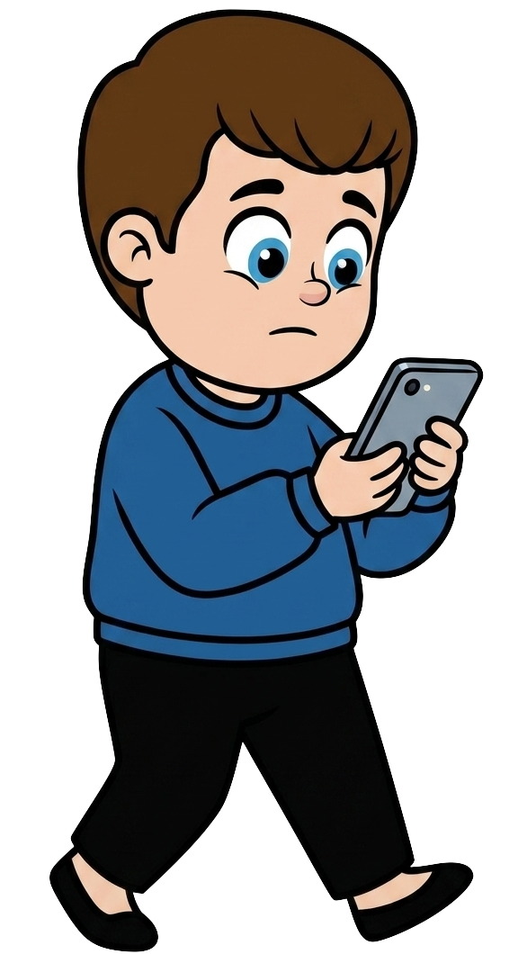
Kai is walking and staring at his phone

Slide 6
Kai is walking and staring at his phone

Slide 7
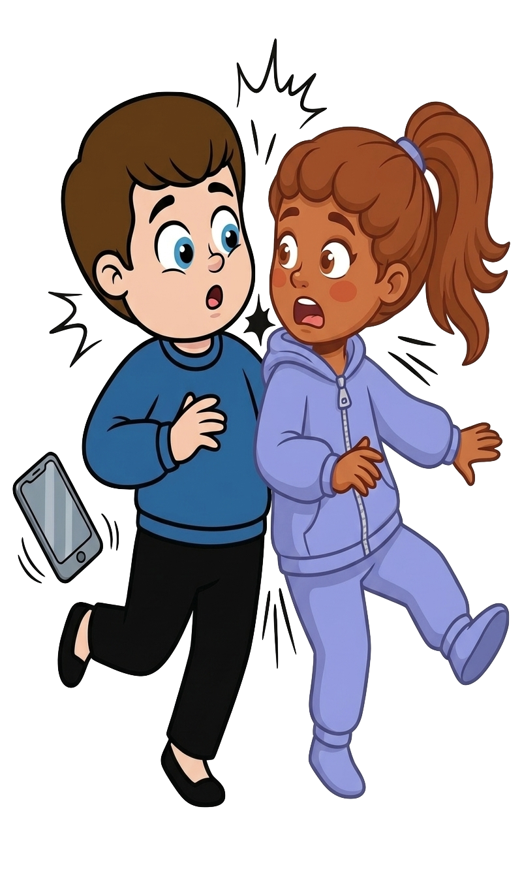
Oh no! Kai bumps into Ruby!

Slide 8
2 of Ruby’s cookies fell!

Slide 9
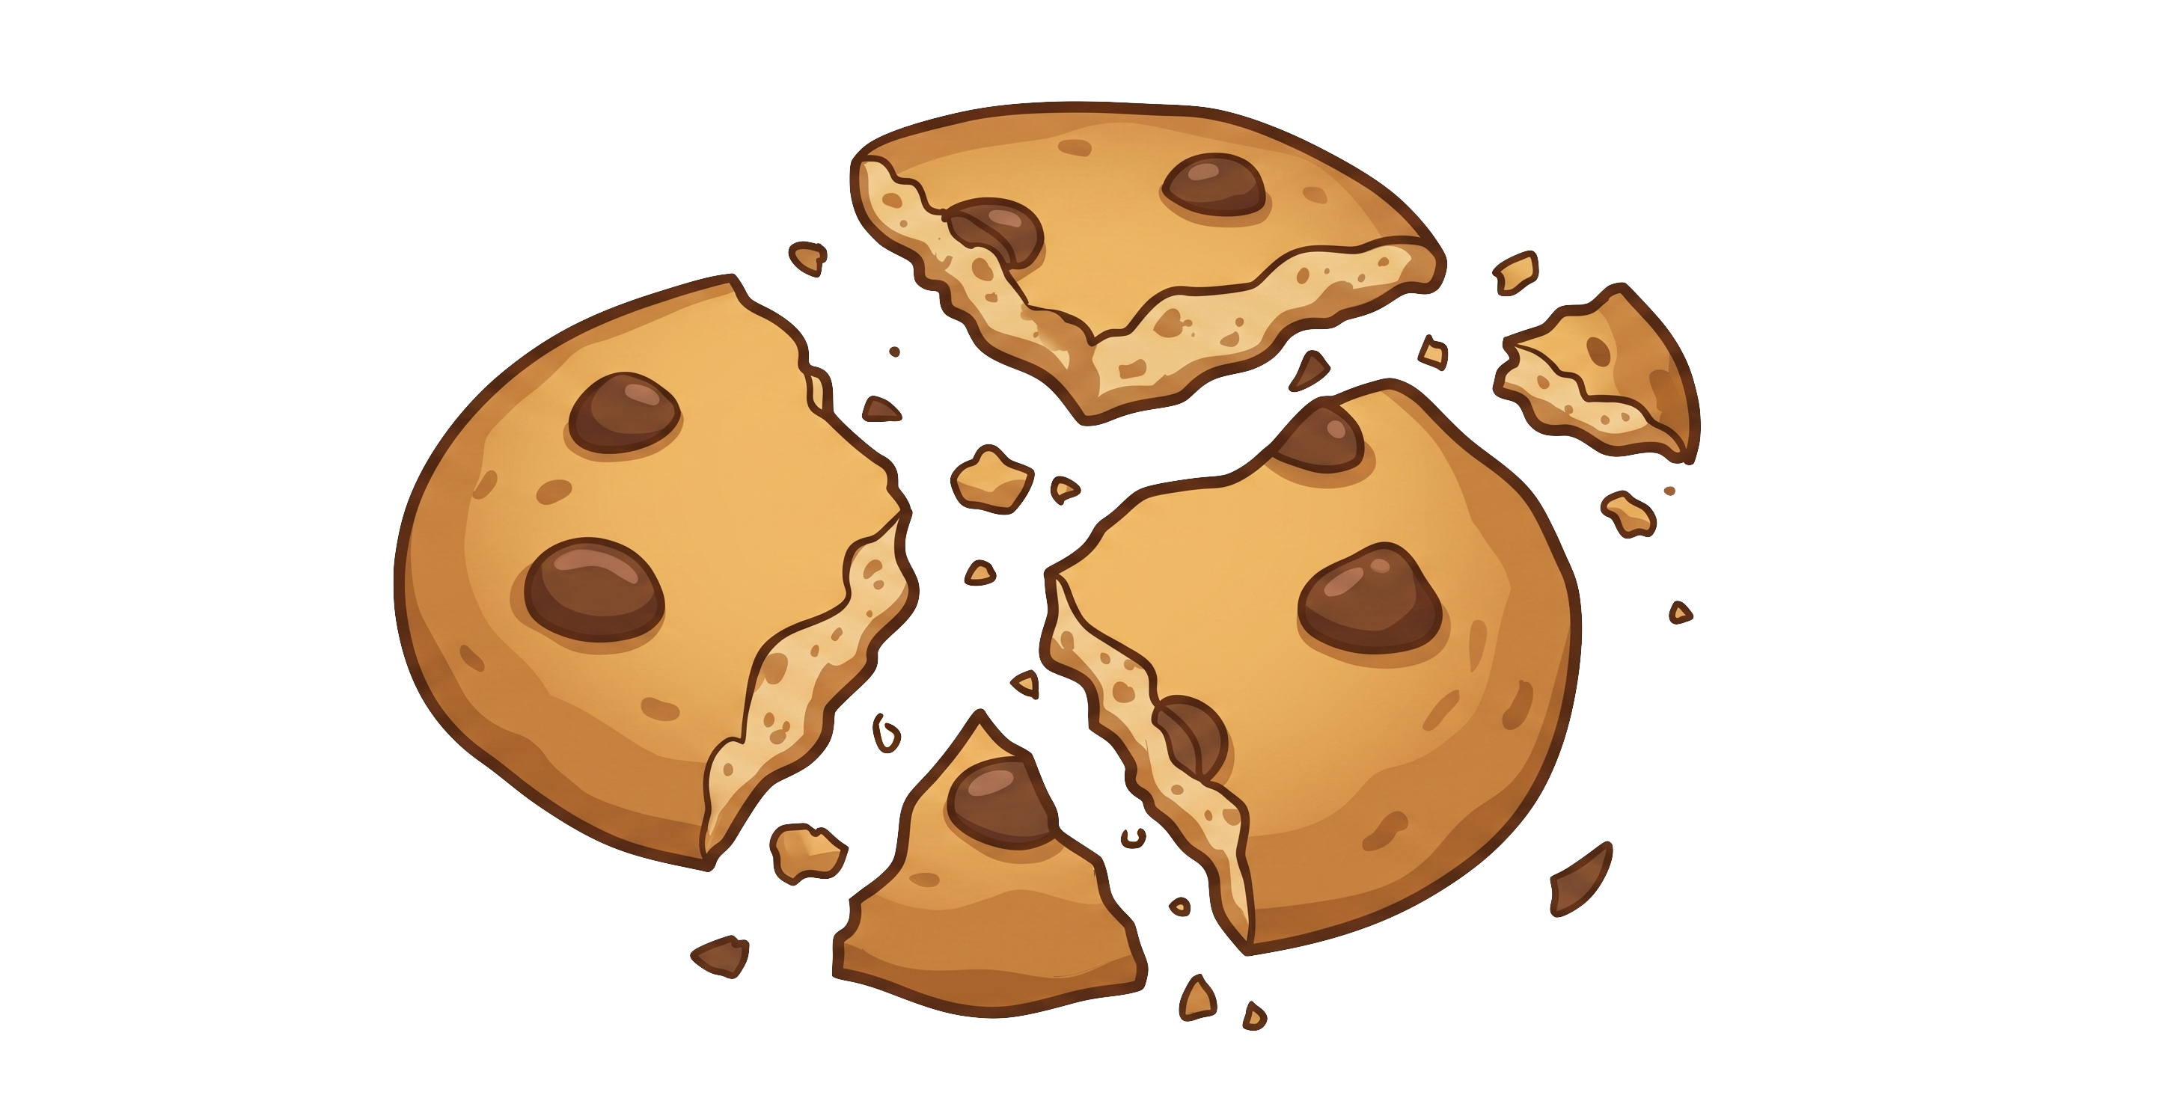
Kai still has 7 cookies. Ruby now has 5 cookies.

